Slide 1



Games using python
Simon says

Slide 2

Group members
Mayur Kharmate – 22207
Shreyas Kulkarni – 22130
Aniket Uttekar - 22155
Kunal Desai - 22114

Slide 3

What is simon says ?
Simon says is a game in which one person is designated Simon, the others are the players. Standing in front of the group, Simon tells players what they must do. However, the players must only obey commands that begin with the words “Simon Says.” If Simon says, “Simon says Memorise and say out loud the numbers 7 , 3 , 5,” then players must the same . If the player fails memorise the sequence of the numbers i.e the work that simon says then that player loses .
In our program the simon just gives us some numbers to memorise which we have to memorise and tell back to the simon in sequence in which they were asked to memorise . If the sequence goes wrong the game will stop and score will be displayed .

Slide 4
Code :
import os
import time
import sys
import random
numbers_to_generate_from = list(range(0,8))
simon_questions_amount = 100
simon_says_list = []
for question in range (simon_questions_amount):
chosen_number = random.choice(numbers_to_generate_from)
simon_says_list.append(chosen_number)
print('THERE ARE SOME NUMBERS YOU HAVE TO MEMORISE: {}'.format(simon_says_list))
time.sleep(3)
os.system('cls')
for num in simon_says_list:
student_answer = int(input('HI I AM SIMON PLEASE ENTER THE NUMBER I ASKED :'))
if student_answer == num:
print ('WELL DONE')
continue
else:
print('WRONG NUMBER :( , GAME OVER !')
print('YOUR SCORE IS: {0}'.format(question))
sys.exit()

Slide 5
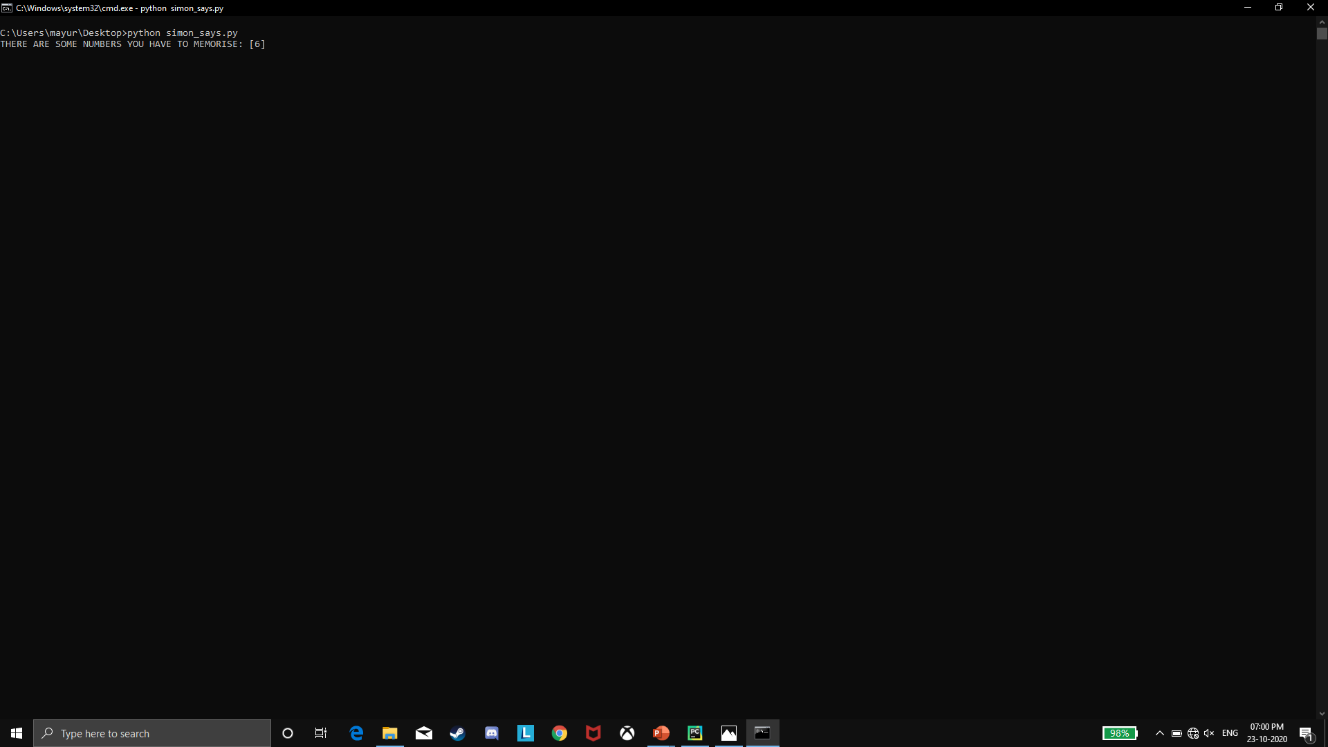
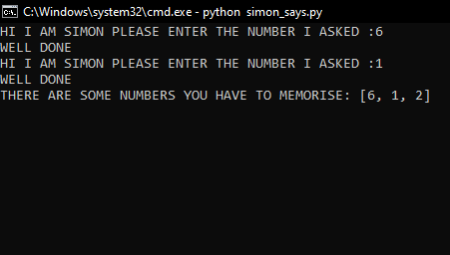
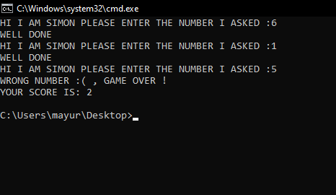
Output :

Slide 6
Thank you !

